Slide 1
Thursday, January 19, 2017
Write In Your Agenda:
Write In Your Monitoring Log:
CW:
Eating for Energy in the Galapagos.
HW:
Finish Eating for Energy in the Galapagos.
Response to Warm-Up:
Name 2 organisms on the Galapagos Islands and how they interact with each other.
You will need:
Pencil
Monitoring Log

Slide 2
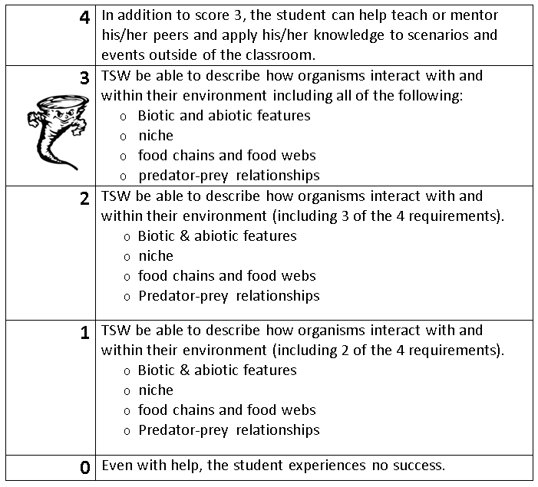
Learning Goal and Scale
TSW be able to describe how organisms interact with and within their environment (including biotic and abiotic features, niche, food chains & webs, and predator-prey relationships).

